Slide 1
Introduction to SystemC
Reference:
﻿SystemC: From the Ground Up 2nd edition by David C. Black
SystemC Language Reference Manual

Slide 2
Standard Methodology for ICs
System-level designers write a C or C++ model
Written in a stylized, hardware-like form
Sometimes refined to be more hardware-like
C/C++ model simulated to verify functionality
Model given to Verilog/VHDL coders
Verilog or VHDL specification written
Models simulated together to test equivalence
Verilog/VHDL model synthesized

Slide 3
Idea of SystemC
C and C++ are being used as ad-hoc modeling languages
Why not formalize their use?
Why not interpret them as hardware specification languages just as Verilog and VHDL were?
SystemC is defined and promoted by the Open SystemC Initiative (OSCI — now Accellera)

Slide 4
What Is SystemC?
A subset of C++ that models/specifies synchronous digital hardware
A collection of simulation libraries that can be used to run a SystemC program
A compiler that translates the “synthesis subset” of SystemC into a netlist

Slide 5
Why we need SystemC
SystemC is a system design and modelling language.
Evolved to meet a system designer’s requirements for designing and integrating complex electronic systems very quickly while assuring that the final system will meet performance expectations.
Thorough functional (and architectural) verification is required to avoid expensive and sometimes catastrophic failures in the device.
Concurrent and multidisciplinary approach to the design of complex systems is electronic system-level design or ESL.
ESL happens by modelling systems at higher levels of abstraction
Portions of the system model are subsequently iterated and refined, as needed.

Slide 6
Why we need SystemC
A set of techniques has evolved called Transaction-Level Modeling or TLM to aide with this task.
ESL and TLM impose a set of requirements on a language that is different than the requirements for hardware description languages (HDLs) or the requirements for traditional software languages like C, C++, or Java
The increasingly shortened time to market requirements
Verify the design in early time
The growing complexity
Integration of developed devices

Slide 7
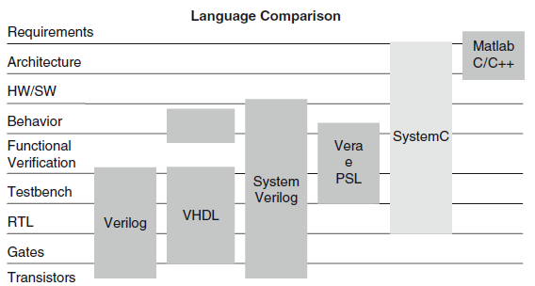
SystemC
Strictly speaking, SystemC is not a language. SystemC is a class library within a well established language, C++.
SystemC is not a solution that will solve every design productivity issue.
In addition, SystemC provides a common language for software and hardware, C++.
Notes:
PSL is an abbreviation for Property Specification Language. A property is a boolean-valued fact about a design-under-test.

Slide 8
Needed tools
SystemC latest library package v2.3.3
Linux platform
GCC compiler
GTKWave – Waveform tool
some text editor

Slide 9
Quick Overview
A SystemC program consists of module definitions plus a top-level function that starts the simulation
Modules contain processes (C++ methods) and instances of other modules
Ports on modules define their interface
Rich set of port data types (hardware modeling, etc.)
Signals in modules convey information between instances
Clocks are special signals that run periodically and can trigger clocked processes
Rich set of numeric types (fixed and arbitrary precision numbers)

Slide 10
Modules
Hierarchical entity
Similar to Verilog’s module
A C++ class definition
Simulation involves
Creating objects of this class
They connect themselves together
Processes in these objects (methods) are called by the scheduler to perform the simulation
Notes:
Example: Consider the Class of Cars. There may be many cars with different names and brand but all of them will share some common properties like all of them will have 4 wheels, Speed Limit, Mileage range etc. So here, Car is the class and wheels, speed limits, mileage are their properties.
A Class is a user defined data-type which have data members and member functions
Data members are the data variables and member functions are the functions used to manipulate these variables
data member will be speed limit, mileage etc and member functions can be apply brakes, increase speed etc

Slide 11
SystemC program structure:
SC_MODULE(<module name>)
{..........
............//this part is described next
...........
};
Every module should have a constructor 'SC_CTOR' with the same name as that of the module. The above module with the constructor looks like :
SC_MODULE(<module name>) {.......... ............//these steps are described next SC_CTOR(<module name>) {........... ............//these steps are described next } };

Slide 12
SC_MODULE(<module name>) { sc_in<datatype> port1;
sc_out<datatype> port2;
SC_CTOR(<module name>) {
SC_METHOD(<process name>);
sensitive << <sensitivity list>;
}
};
Note that the constructor itself calls the process which means that
all the processes are executed when ever an object of the module is instantiated or
the value of any of the signal or port in the sensitivity list changes.
Notes:
Constructors are special class members which are called by the compiler every time an object of that class is instantiated. Constructors have the same name as the class and may be defined inside or outside the class definition.

Slide 13
Modules
SC_MODULE(mymod) {
/* port definitions */
/* signal definitions */
/* clock definitions */
/* storage and state variables */
/* process definitions */
SC_CTOR(mymod) {
/* Instances of processes and modules */
}
};

Slide 14
Ports
Define the interface to each module
Channels through which data is communicated
Port consists of a direction
input sc_in
output sc_out
bidirectional sc_inout
and any C++ or SystemC type

Slide 15
Ports
SC_MODULE(mymod) {
sc_in<bool> load, read;
sc_inout<int> data;
sc_out<bool> full;
/* rest of the module */
};

Slide 16
Signals
Convey information between modules within a module
Directionless: module ports define direction of data transfer
Type may be any C++ or built-in type

Slide 17
Signals
SC_MODULE(mymod) {
/* port definitions */
sc_signal<sc_uint<32> > s1, s2;
sc_signal<bool> reset;
/* … */
SC_CTOR(mymod) {
/* Instances of modules that connect to the signals */
}
};

Slide 18
Processes
Procedural code with the ability to suspend and resume
Like Verilog’s initial blocks

Slide 19
Three Types of Processes
Method processes (SC_METHOD) – similar to Verilog always block
Thread processes (SC_THREAD) – similar to Verilog initial block
CThread processes (SC_CTHREAD) – similar to SC_THREAD but sensitive to a particular clock edge
Notes:
Process Usage:
System Algorithmic models tend to use Threads or untimed Methods
System Performance models tend to use both
Transaction Level Models tend to use both
Behavioral/Algorithmic Synthesis models tend to use clocked Threads
RTL models use Methods
Test benches may use all process types (Threads and Methods)

Slide 20
METHOD Processes
Triggered in response to changes on inputs
Cannot store control state between invocations
Designed to model blocks of combinational logic

Slide 21
METHOD Processes
Process
SC_MODULE(onemethod) {
sc_in<bool> in;
sc_out<bool> out;
void inverter();
SC_CTOR(onemethod) {
SC_METHOD(inverter);
sensitive <<in;
}
};
Instance of the process created
and made sensitive to an input

Slide 22
METHOD Processes
Invoked once every time input “in” changes
Should not save state between invocations
Runs to completion: should not contain infinite loops
void inverter() {
bool internal;
internal = in;
out = ~internal;
}
Read a value from the port
Write a value to an output port

Slide 23
THREAD Processes
Triggered in response to changes on inputs
Can suspend itself and be reactivated
Uses wait
Scheduler runs it again later
Designed to model just about anything

Slide 24
THREAD Processes
Process is simply a method of this class
SC_MODULE(onemethod) {
sc_in<bool> in;
sc_out<bool> out;
void toggler();
SC_CTOR(onemethod) {
SC_THREAD(toggler);
sensitive << in;
}
};
Instance of this process created

Slide 25
CTHREAD Processes
Triggered in response to a single clock edge
Can suspend itself and be reactivated
Uses wait
Scheduler runs it again later
Designed to model clocked digital hardware

Slide 26
CTHREAD Processes
Instance of this process created and relevant clock edge assigned
SC_MODULE(onemethod) {
sc_in_clk clock;
sc_in<bool> trigger, in;
sc_out<bool> out;
void toggler();
SC_CTOR(onemethod) {
SC_CTHREAD(toggler, clock.pos());
}
};

Slide 27
Ports and Signals
Types of ports and signals:
All natives C/C++ types
All SystemC types
User defined types
How to declare
IN : sc_in<port_type>
OUT : sc_out<port_type>
Bi-Directional : sc_inout<port_type>

Slide 28
Ports and Signals
How to read and write a port ?
Methods read( ); and write( );
Examples:
in_tmp = in.read( ); //reads the port in to in_tmp
out.write(out_temp); //writes out_temp in the out port

Slide 29
Ports and Signals
Ports of a module are the external interfaces that pass information to and from a module
In SystemC one port can be IN, OUT or INOUT
Signals are used to connect module ports allowing modules to communicate
Very similar to ports and signals in VHDL

Slide 30
//andgate.h
#include "systemc.h"
SC_MODULE(andgate)
{
sc_in<bool> a1;
sc_in<bool> b1;
sc_in<bool> c1;
sc_out<bool> d1;
void compute_and()
{
d1.write(a1.read() && b1.read) && (c1.read());
}
SC_CTOR(andgate)
{
SC_METHOD(compute_and);
sensitive <<a1 <<b1 <<c1;
}
};

Slide 31
//driver.h
#include "systemc.h"
SC_MODULE(driver)
{ sc_out<bool> a1,b1,c1;
void inputs()
{
a1.write(false);
b1.write(false);
c1.write(false); wait(5,SC_NS);
a1.write(true);
b1.write(true);
c1.write(true); wait(5,SC_NS); }
SC_CTOR(driver)
{
SC_THREAD(inputs);
sensitive <<a1 <<b1 <<c1;
}
};

Slide 32
//monitor.h
#include "systemc.h"
SC_MODULE(monitor){
sc_in<bool> a1,b1,c1,d1;
void mon()
{
cout << "Inputs: "<<a1 <<b1 <<c1 << " Output: "<<d1 <<endl;
}
SC_CTOR(monitor)
{
SC_METHOD(mon);
sensitive <<a1 <<b1 <<c1;
}
};
Notes:
argc (argument count) and argv (argument vector)
but they can be given any valid identifier: int main(int num_args, char** arg_strings) is equally valid
They can also be omitted entirely, yielding int main(), if you do not intend to process command line arguments.
Ex: ./test a1 b2 c3

Slide 33
//main program – main.
#include "systemc.h"
#include "andgate.h"
#include "driver.h"
#include "monitor.h"
int sc_main( int argc, char* argv[] ) {
sc_signal <bool> a1,b1,c1,d1;
andgate agate("andgate");
driver drive("driver");
monitor mon("monitor");
agate.a1(a1); agate.b1(b1); agate.c1(c1); agate.d1(d1);
drive.a1(a1); drive.b1(b1); drive.c1(c1); mon.a1(a1);
mon.b1(b1); mon.c1(c1); mon.d1(d1);
//Waveform
sc_trace_file *Tf;
Tf = sc_create_vcd_trace_file("traces");
sc_trace(Tf, a1, "a1");
sc_trace(Tf, b1, "b1");
sc_trace(Tf, c1, "c1");
sc_trace(Tf, d1, "d1");
sc_start(30,SC_NS);
sc_close_vcd_trace_file(Tf);
return 0;
}
Notes:
argc (argument count) and argv (argument vector)
but they can be given any valid identifier: int main(int num_args, char** arg_strings) is equally valid
They can also be omitted entirely, yielding int main(), if you do not intend to process command line arguments.
Ex: ./test a1 b2 c3

Slide 34
Compile and Run using systemc-2.3.3
Open a new terminal in the Source Directory
g++ -I. -I$SYSTEMC_HOME/include -L. -L$SYSTEMC_HOME/lib-linux64 -o sim design.cpp –lsystemc
./sim
gtkwave traces.vcd

Slide 35
Compile and Run using Cadence
csh
source /cad/cshrc
irun –sysc main.cpp –lrt –sctop sc_main +gui
Notes:
irun -helpall

Slide 36
Clocks
Special object
How to create ?
sc_clock clock_name (“clock_label”, period, duty_ratio, offset, initial_value );
Clock connection
f1.clk( clk_signal ); //where f1 is a module
Clock example:

Slide 37
Data Types
SystemC supports:
C/C++ native types
SystemC types
SystemC types
Types for systems modelling
2 values (‘0’,’1’)
4 values (‘0’,’1’,’Z’,’X’)
Arbitrary size integer (Signed/Unsigned)
Fixed point types

Slide 38
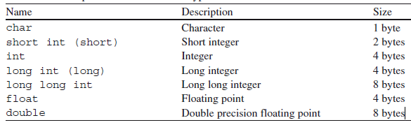
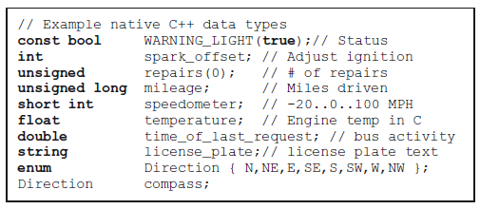
Native C++ Data Types

Slide 39
SystemC types
Type | Description
sc_logic | Simple bit with 4 values(0/1/X/Z)
sc_int | Signed Integer from 1-64 bits
sc_uint | Unsigned Integer from 1-64 bits
sc_bigint | Arbitrary size signed integer
sc_biguint | Arbitrary size unsigned integer
sc_bv | Arbitrary size 2-values vector
sc_lv | Arbitrary size 4-values vector
sc_fixed | templated signed fixed point
sc_ufixed | templated unsigned fixed point
sc_fix | untemplated signed fixed point
sc_ufix | untemplated unsigned fixed point
Notes:
sc_fix* - Fixed Point Numbers (DSP)

Slide 40
SC_LOGIC type
More general than bool, 4 values :
(‘0’ (false), ‘1’ (true), ‘X’ (undefined) , ‘Z’(high-impedance) )
Declaration
sc_logic my_logic;
Assignment like bool
my_logic = ‘0’;
my_logic = ‘Z’;
Simulation time bigger than bool

Slide 41
Fixed precision integers
Used when arithmetic operations need fixed size arithmetic operands
INT can be converted in UINT and vice-versa
“int” in C++
The size depends on the machine
Faster in the simulation
1-64 bits integer in SystemC
sc_int<n> -- signed integer with n-bits
sc_uint<n> -- unsigned integer with n-bits

Slide 42
Arbitrary precision integers
Integer bigger than 64 bits
sc_bigint<n>
sc_biguint<n>
More precision, slow simulation
Can be used together with:
Integer C++
sc_int, sc_uint

Slide 43
Other SystemC types
Bit vector
sc_bv<n>
2-value vector (0/1)
Not used in arithmetics operations
Faster simulation than sc_lv
Logic Vector
sc_lv<n>
Vector to the sc_logic type
Assignment operator (“=“)
my_vector = “XZ01”

Slide 44
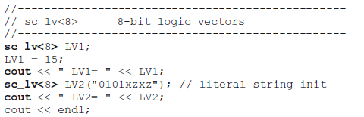
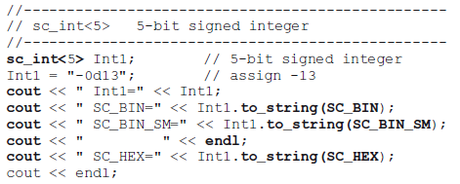
String Input and Output
SystemC data types may be converted to a standard C++ string using the data type’s to_string method
Notes:
Instances of the SystemC data types may be converted to a standard C++ string using the data type’s to_string method

Slide 45
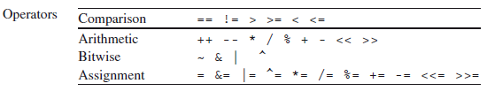
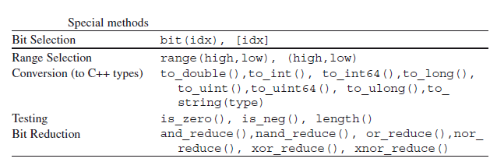
Operators for SystemC Data Types

Slide 46
Example
sc_bv<5> positions = "01101";
sc_bv<6> mask = "100111";
sc_bv<5> active = positions & mask;// 00101
sc_bv<1> all = active.and_reduce(); // SC_LOGIC_0
positions.range(3,2) = "00";// 00001
positions[2] = active[0] ^ flag;

Slide 47
Exercises
Write a program to read 10 data from a file using the unified string representation and store in an array of sc_uint<W>. Output the values as SC_DEC and SC_HEX_SM.
Write a program to generate 10 random values and compute the squares of these values. Do the math using each of the following data types: short, int, unsigned, long, sc_int<8>, sc_uint<19>, sc_bigint<8>, sc_bigint<100>. Be certain to generate numbers distributed over the entire range of possibilities.
Write a Systemc program to count down from 3 to 1 and display the corresponding words “Ready”, “Set”, “Go” with each count. Compile and run.

Slide 48
A Notion of Time
Wall-clock time, processor time, and simulated time
The simulation’s wall-clock time is the time from the start of execution to completion, including time waiting on other system activities and applications
The simulation’s processor time is the actual time spent executing the simulation, which will always be less than the simulation’s wall-clock time
The simulated time is the time being modeled by the simulation
sc_time - represented by a minimum of a 64-bit unsigned integer
used by the simulation kernel to track simulated time and to specify delays and timeouts.
Notes:
For example, it might take 2 seconds by your watch (wall-clock time) to simulate 15 ms (simulated time) of your design, but it may only take 1 second (processor time) of the CPU because another program was hogging the processor.

Slide 49
A Notion of Time
SC_FS, SC_PS, SC_NS, SC_US, SC_MS,SC_SEC
All objects of sc_time use a single (global) time resolution that has a default of 1 picosecond
sc_time_stamp ()
cout << " The time is now “ << sc_time_stamp()
The time is now 0 ns
sc_start() - used to start simulation
sc_start(60.0,SC_SEC); // Limit sim to one minute
wait(sc_time) – delays in SC_THREAD processes

Slide 50
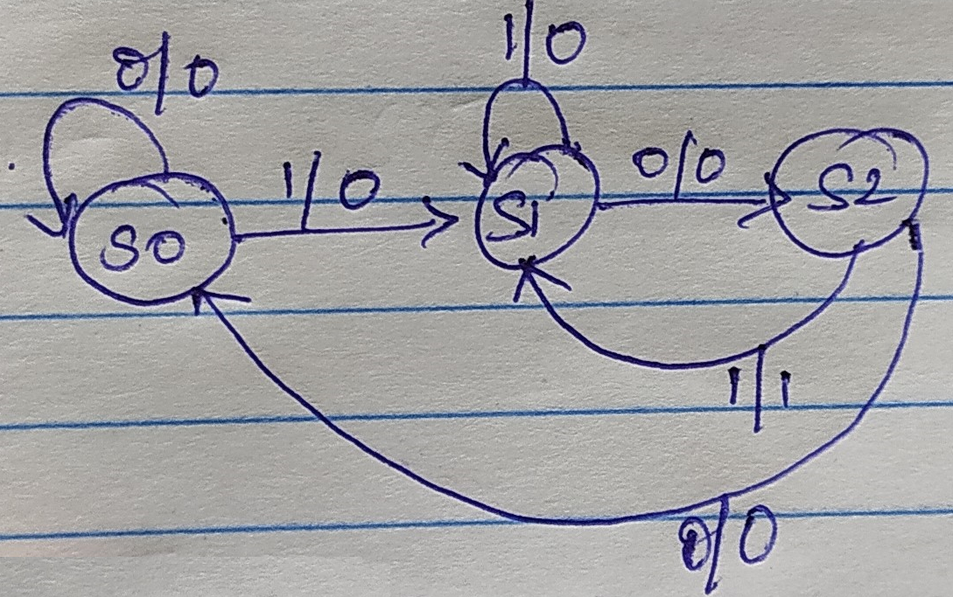
//fsm.h detect 101 overlapping sequence
#include "systemc.h"
SC_MODULE(fsm){
sc_in<bool> rst, in, clk;
sc_out<bool> out;
sc_uint<2> state,next_state;
void update_state(){
if (rst.read() == true){
state = 0; }
else {
state = next_state; }
}
void ns_logic(){
// Determine next state and output
switch(state) {
case 0:
if (in.read()) {
next_state = 1;
out=0;}
else {
next_state = 0;
out=0;}
break;

Slide 51
case 1:
if (in.read()){
next_state = 1;out=0;}
else{
next_state = 2;out=0;}
break;
case 2:
if (in.read()){
next_state = 1;out=1;}
else{
next_state = 0;out=0;}
break;
default:
{
next_state = 0;out=0;}
break;
}
}

Slide 52
SC_CTOR(fsm){
SC_METHOD(update_state);
sensitive << clk.pos()<<rst;
SC_METHOD(ns_logic);
sensitive <<clk.pos()<<in<<rst;
}};
rst.write(false);
in.write(true);
wait();
in.write(false);
wait();
in.write(true);
wait();
in.write(false);
wait();
}
SC_CTOR(driver)
{
SC_THREAD(inputs);
sensitive << clk.pos();
}
};
#include "systemc.h"
SC_MODULE(driver)
{
sc_out<bool>rst,in;
sc_in<bool>clk;
void inputs()
{
rst.write(false);
in.write(true);
wait();
rst.write(true);
in.write(true);
wait();

Slide 53
#include "systemc.h"
SC_MODULE(monitor)
{
sc_in<bool> rst, in,out;
sc_in<bool> clk;
void mon()
{
while (true){
cout << sc_time_stamp();
cout << " rst "<<rst.read();
cout << " clk "<<clk.read();
cout << " in "<<in.read();
cout << " out "<<out.read() <<endl;
wait();
}}
SC_CTOR(monitor)
{
SC_THREAD(mon);
sensitive << clk.pos();
}};

Slide 54
#include "systemc.h"
#include "driver.h"
#include "monitor.h"
#include "fsm.h"
int sc_main(int argc, char* argv[])
{
sc_signal <bool> rst,in,out;
sc_clock clk("TestClock",10,SC_NS,0.5);
fsm f_sm("state_machine");
driver drive("driver");
monitor mon("monitor");
f_sm.rst(rst);
f_sm.in(in);
f_sm.clk(clk);
f_sm.out(out);
drive.rst(rst);
drive.in(in);
drive.clk(clk);
mon.rst(rst);
mon.in(in);
mon.out(out);
mon.clk(clk);
//Waveform
sc_trace_file *Tf;
Tf = sc_create_vcd_trace_file("traces");
sc_trace(Tf, rst, "rst");
sc_trace(Tf, in, "in1");
sc_trace(Tf, clk, "clk");
sc_trace(Tf, out, "out");
sc_trace(Tf, f_sm.state, "state");
sc_start(100,SC_NS);
sc_close_vcd_trace_file(Tf);
return 0;
}

Slide 55
Basic Channels
Primitive Channels
sc_mutex, sc_semaphore, and sc_fifo<T>
sc_mutex - Mutex is short for mutually exclusive text
A program object that lets multiple program threads share a common resource, such as file access, without colliding
A mutex will be in one of two exclusive states: unlocked or locked.
Only one process can lock a given mutex at one time.
A mutex can only be unlocked by the particular process that locked the mutex, but may be locked subsequently by a different process.
sc_mutex class comes with pre-defined methods as below.
int lock() : Lock the mutex if it is free, else wait till mutex gets free.
int unlock() : Unlock the mutex
int trylock() : Check if mutex is free, if free then lock it else return -1.
Notes:
SystemC’s primitive channels are known as primitive because they contain no hierarchy, no simulation processes, and are designed simple to be very fast
char* kind() : Return string "sc_mutex"

Slide 56
Example of sc_mutex used in bus class
Used with an SC_METHOD process, access might look like this
sc_module bus{
sc_mutex bus_access;
…
void write(int addr, int data) {
bus_access.lock();
// perform write
bus_access.unlock();
}
…
};
void grab_bus_method() {
if (bus_access.trylock() == 0) {
// access bus
…
bus_access.unlock();
}
}

Slide 57
sc_semaphore
For some resources, more than one copy or owner is required
Ex: parking spaces in a parking lot
A multiport memory model
class multiport_RAM {
sc_semaphore read_ports(3);
sc_semaphore write_ports(2);
…
void read(int addr, int& data) {
read_ports.wait();
// perform read
read_ports.post();
}
void write(int addr, const int& data) {
write_ports.wait();
// perform write
write_ports.post();
}
…
};//endclass

Slide 58
sc_fifo
Predefined primitive channel intended to model the behavior of a fifo, that is, a first-in first-out buffer. Each fifo has a number of slots for storing values.
The number of slots is fixed when the object is constructed. Default slot size is 16.
sc_fifo has following predefined methods.
write() : This method write the values passed as an argument into the fifo. If fifo if full then write() function waits till fifo slot is available
nb_write() : This method is same as write(), only difference is, when fifo is full nb_write() does not wait till fifo slot is avaible. Rather it returns false.
read() : This method returns the least recent written data in fifo. If fifo is empty, then read() function waits till data is available in fifo.
nb_read() :This method is same as read(), only difference is, when fifo is empty, nb_read() does not wait till fifo has some data. Rather it returns false.
num_available() : This method returns the numbers of data values available in fifo in current delta time.
num_free() : This method returns the number of free slots available in fifo in current delta time.

Slide 59
Example
#include "systemc.h"
SC_MODULE(example_fifo) {
// Declare the FIFO
sc_fifo<int> packet_fifo;
void fiforead(void) {
int val;
for (;;) {
wait(3, SC_NS);
packet_fifo.read(val);
cout << sc_time_stamp() << ": Read " << val <<endl;
cout << sc_time_stamp()<<"No.of Data in FIFO "<<packet_fifo.num_available()<<endl;
}
}
Notes:
The SC_METHOD implements dynamic sensitivity with a next_trigger(arg) command

Slide 60
Example
void fifowrite(void) {
int val = 10;
for (;;) {
wait(2, SC_NS);
val++;
packet_fifo.write(val);
cout << sc_time_stamp() << ": wrote " << val << " No.
of Free Slots in FIFO " <packet_fifo.num_free()<<endl;
}
}
Notes:
The SC_METHOD implements dynamic sensitivity with a next_trigger(arg) command

Slide 61
Example
SC_CTOR(example_fifo) :packet_fifo(25)
{
SC_THREAD(fifowrite);
SC_THREAD(fiforead);
}
};
#include "systemc.h"
#include "fifo.h"
int sc_main(int argc, char* argv[]) {
example_fifo ex_fifo ("ex_fifo0");
sc_start(10, SC_NS);
return 0;
}
Notes:
The SC_METHOD implements dynamic sensitivity with a next_trigger(arg) command

Slide 62
SystemC Highlights
Support Hardware-Software Co-Design
Interface in a C++ environment
Modules
Container class includes hierarchical Entity and Processes
Processes
Describe functionality, Event sensitivity
Ports
Single-directional(in, out), Bi-directional(inout) mode
Signals
Resolved, Unresolved signals
Rich set of port and signal types
Rich set of data types
All C/C++ types, 32/64-bit signed/unsigned, fixed-points, MVL, user defined

Slide 63
SystemC Highlights
Interface in a C++ environment (continued)
Clocks
Special signal, Timekeeper of simulation and Multiple clocks, with arbitrary phase relationship
Cycle-based simulation
High-Speed Cycle-Based simulation kernel
Multiple abstraction levels
Untimed from high-level functional model to detailed clock cycle accuracy RTL model
Communication Protocols
Debugging Supports
Run-Time error check
Waveform Tracing

